Slide 1
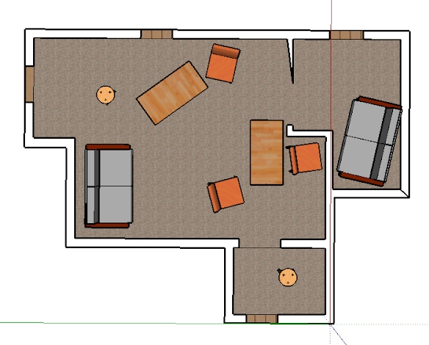
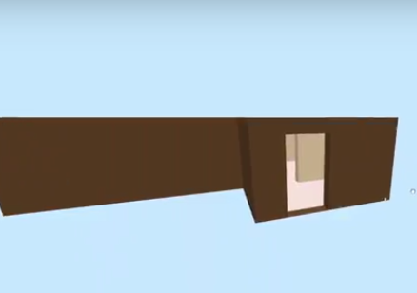

Dynamic Generation of Interior Building Models Given A 2D Floor Plan Joseph Schiarizzi, Mikey Wong
Motivation
Methods
Results
1,200,000 Residential construction projects in the US in September 2017
217,000 SketchUp Interior Designers
Many man-hours and dollars spent to create interior models.
An interactive webVR experience was created for naïve furniture placements, after corner points were used properly.
Objective
Reduce time and cost associated with building 3D models and to make them more accessible to the general public. By automating the entire process, users will no longer need to have the technical expertise necessary to operate CAD software, and will be able to view these buildings in WebVR for a virtual walkthrough.
Conclusions
Interactive models can be generated dynamically.
The process of creating the model can be automated from an image of a floor plan to using the model in webVR.
More research is needed on the ability of A.I. to create aesthetically pleasing designs.
Background
Current processes for turning floorplans into 3D models is entirely and involves Automated Computer Assisted Design (AutoCAD) software as well as the technical expertise to operate such software.
Market Impact
Cost of a modeled interior could be brought down from $1500 to $5 each iteration.
Over 5 Million models created in a year

